Slide 1
Service based IT Companies in India
Team E

Slide 2
Problem Statement
Retrieving the required services provided by multiple software companies and choosing accordingly.

Slide 3
Problem Approach
Creating a database consisting of company name and services provided, pricing if any using My SQL.
Retrieving the required output from the database.

Slide 4
Contribution
Database creation using My SQL - Isaac.
User Login Interface - Hrushi.
Giving the input data - Srikanth.
Retrieving the output data - Sanju.
Working on PPT - Jacob.

Slide 5
Technology Used
Used MySQL to create database.
Used tkinter for GUI.
Used My SQL.Connector to connect python with database.

Slide 6
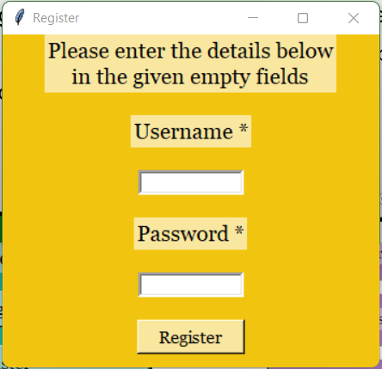
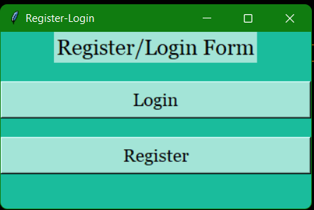
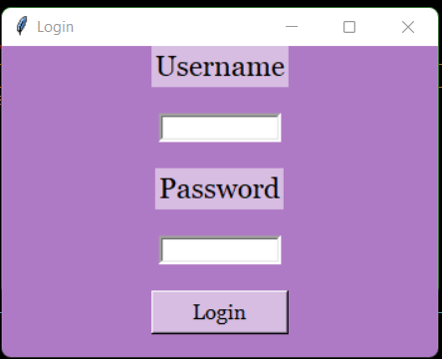
Work Flow
User Registers to the Platform.
Using Credentials the user will get Logged in.
User can search for services or the company.
The output will be shown.

